Slide 1
Regression Analysis
Analysis of Variance
Nicoleta Serban, Ph.D.
Professor
School of Industrial and Systems Engineering
Model Fit Assessment

Slide 2

About This Lesson

Slide 3
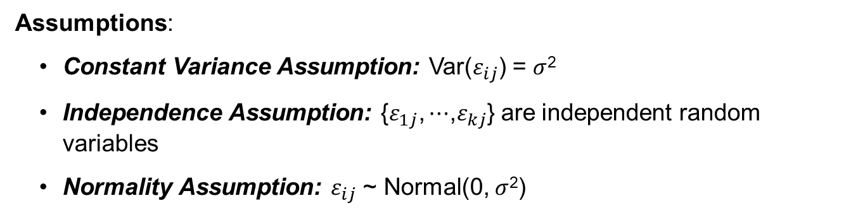
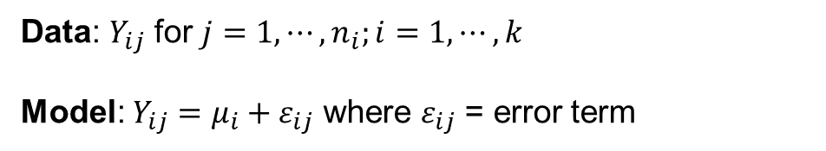
ANOVA: Model & Assumptions
Data: $Y_{ij}$ for $j=1,⋯,n_{i};i=1,⋯,k$
Model: $Y_{ij}=μ_{i}+ε_{ij}$ where $ε_{ij}$ = error term
Assumptions:
Constant Variance Assumption: Var($ε_{ij}$) = $σ$²
Independence Assumption: {$ε_{1j}\text{,}⋯$,$ε_{kj}$} are independent random variables
Normality Assumption: $ε_{ij}$ ~ Normal(0, $σ$²)

Slide 4

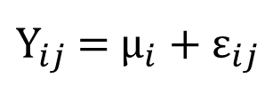
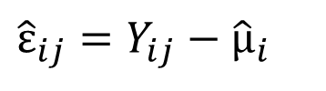
Residual Analysis
${\text{Y}}_{ij}$ = ${\text{μ}}_{i}+{\text{ε}}_{ij}$
In the model,${\text{ε}}_{ij}$is the error term. We want ${\text{ε}}_{ij}$~ N(0, $σ$²). To check to see if this is true, we examine the residual errors:
$${\hat{\text{ε}}}_{ij}=Y_{ij}−{\hat{\text{μ}}}_{i}$$
If the model fit is a good fit, then the residuals should be scattered around zero (randomly).

Slide 5
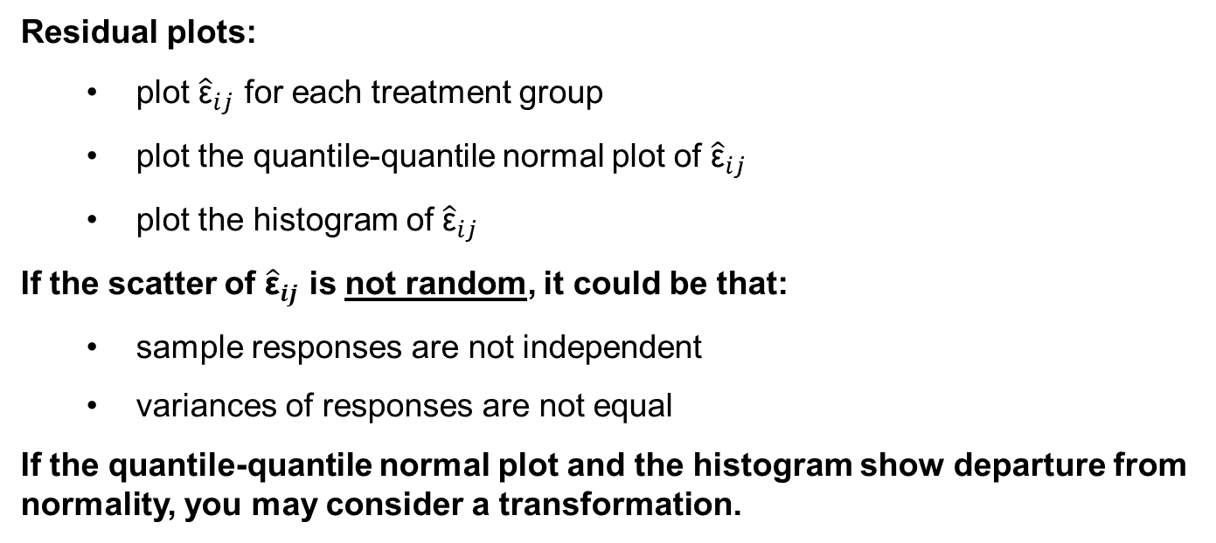
Residual Analysis
Residual plots:
  plot ${\hat{\text{ε}}}_{ij}$ for each treatment group
  plot the quantile-quantile normal plot of ${\hat{\text{ε}}}_{ij}$
  plot the histogram of ${\hat{\text{ε}}}_{ij}$
If the scatter of ${\hat{\text{ε}}}_{ij}$ is not random, it could be that:
  sample responses are not independent
  variances of responses are not equal
If the quantile-quantile normal plot and the histogram show departure from normality, you may consider a transformation.

Slide 6
Residual Plot Example 1
Non-constant
variance

Slide 7
Residual Plot Example 2
Clusters of residuals:
Correlated errors

Slide 8

Example1: Global Suicide by Region
Is the ANOVA model a good fit?

Slide 9
Residual Analysis
## Discard groups with 1 observation
region = suicide_data$region
groups.1 = c(which(region=="NORTHERN AMERICA"),which(region=="WESTERN ASIA"))
suicide_data = suicide_data[-groups.1,]
model.1 = aov(suicidesper100k ~ region, data=suicide_data)
## Diagnostic plots
plot(model.1)
resid.model.1=residuals(model.1)

Slide 10
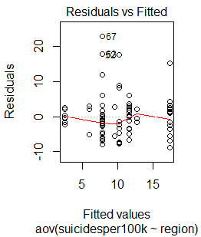
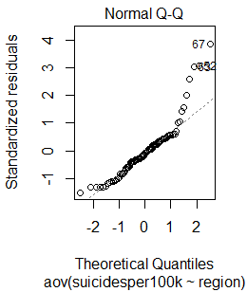
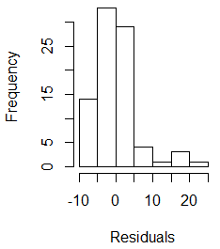
Residual Analysis

Slide 11

Summary

